Slide 1
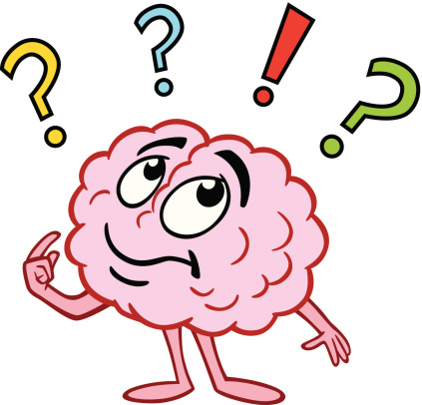
Central Nervous System – Brain
Chapter 5 HP
Corpus Callosum
Cerebellum
Hypothalamus
Medulla Oblongata
Spinal Cord

Slide 2
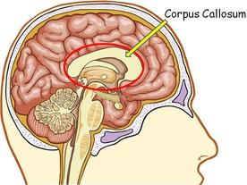
Corpus Callosum
Wide band of nerve fibres
At base of longitudinal fissure
Allow 2 sides of cerebrum to communicate

Slide 3
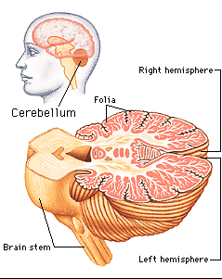
Cerebellum
Under rear of cerebrum
Highly folded surface
Control over:
Balance
Posture
Fine coordination of voluntary muscle movement
Receives input from inner ear, stretch receptors in skeletal muscles.
“smooths” and coordinates movement.

Slide 4
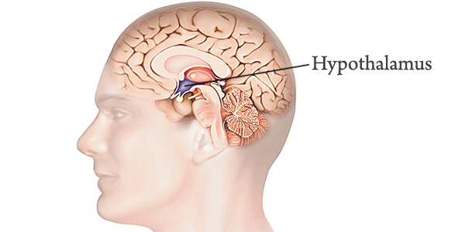
Hypothalamus
Deep in middle of brain
Small but controls many activities
Homeostatic control
Autonomic nervous system coordination
Body temperature
Food and water intake
Emotional responses
Coordination of parts of endocrine system
Metabolism
Growth
Reproduction
Responses to stress

Slide 5
Medulla Oblongata
Continuation of spinal cord at base of brain.
Nerve fibres pass through on the way to other centres
Also has role in coordinating key body functions:
Cardiac centre: rate and force of heartbeat
Respiratory centre: rate and depth of breathing
Vasomotor centre: diameter of blood vessels – blood pressure
Swallowing, coughing, sneezing, vomiting reflexes
Interacts with hypothalamus and other higher brain centres to control homeostasis.

Slide 6
Spinal Cord
Extends from base of skull down spinal column
Heavily protected by bone, meninges, CSF
Grey matter at centre, white matter at outside
White matter in bundles
Ascending tracts – sensory axons
Descending tracts – motor axons
Carries impulses up and down between brain and body
Coordinates some reflexes

Slide 7
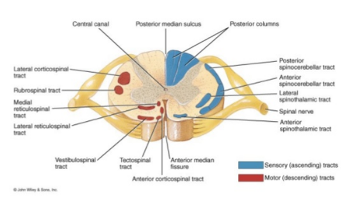

Slide 8
